Slide 1

SUMMATIVE ORAL PRESENTATION FOR PROBLEM A (ETCEMBLY LTD) GROUP NO - 4
DATA SCIENCE MINI PROJECT 2024
SHALOMI FERNANDES,
JIADONG XU,
FANGNAN WEI,
JIAHUI LIU.

Slide 2
PRE-PROCESSING STEPS:
Data preprocessing includes four steps: retaining relevant columns of data, deleting rows with missing values, deleting duplicate rows, and deleting rows with ‘vdjdb.score’ = 0.
Extract relevant columns: 'complex.id', 'gene', 'cdr3', 'v.segm', 'j.segm', 'species', 'mhc.a', 'mhc.b', ' from the original data set mhc.class', 'antigen.epitope', 'vdjdb.score’.
Find the missing values and find that there are missing values in the ‘v.segm’ and ‘j.segm’ columns. Delete the rows where these missing values are located.
Remove duplicate rows
Because the data entry of ‘vdjdb.score’ = 0 has no reference significance, delete the row where ‘vdjdb.score’ = 0 is located.

Slide 3
ENCODING METHODS USED: ONE-HOT We use three methods for encoding, they are ONE-HOT, BLOSUM 62 and GIANA ENCODING.
ONE-HOT is one of the most basic and common encoding methods, which can represent categorical variables as binary vectors. Each vector has a vector representing its possible values, and the length of the vector is the same as the length of the possible values. In this vector, only one element is 1, which is used to represent the category; the other elements are 0.
Although ONE-HOT can achieve encoding, it cannot capture the sequential nature of amino acids, which will lead to the loss of important structural and functional information. Therefore, we have also tried other encoding methods, such as BLOSUM 62 and GIANA ENCODING.

Slide 4
ENCODING METHODS USED: BLOSUM 62 AND GIANA ENCODING
BLOSUM 62 is a protein sequence encoding method based on the statistical analysis of a large number of known protein sequences. It scores amino acids based on the frequency of pairs of amino acids observed in related proteins, capturing similarities and differences between sequences in a biologically meaningful way. In this study, each amino acid is mapped to a vector whose length is equal to the number of rows of the matrix, and each element in the vector represents the similarity score of that amino acid to the corresponding row in the substitution matrix.
GIANA ENCODING is a mathematical framework for converting CDR3 sequences, converting sequence comparisons into nearest neighbor searches in high-dimensional Euclidean space. We used the GIANA package in Python to encode alpha chain, beta chain, chain with alpha and beta respectively.

Slide 5
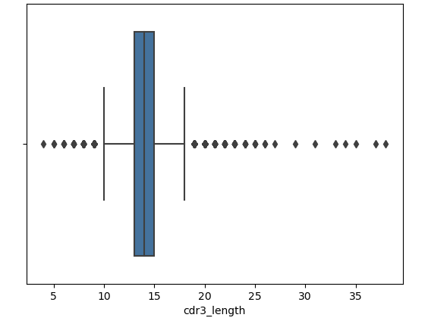
DATA EXPLORATION INSIGHTS:
- Epitopes with fewer than 10 occurrences are considered insufficient for reliable modeling and are thus filtered out. This focuses the dataset on more common epitopes, which improves the model's ability to learn relevant patterns and make accurate predictions.
- Calculation of the length of each CDR3 sequence and retaining those within a practical range (10 to 20 amino acids) is done as depicted by the box plot shown in the Fig, as very short or very long sequences might represent sequencing errors or unusual variations that could skew the model training.
- Further, filtration of the dataset was done to exclude rows where complex.id is 0 which removed entries that did not meet certain criteria essential for the analysis, such as incomplete data entries or placeholders that do not correspond to actual TCR sequences. Doing this ensures that the dataset consists only of meaningful and relevant entries, enhancing the quality of our training data.

Slide 6
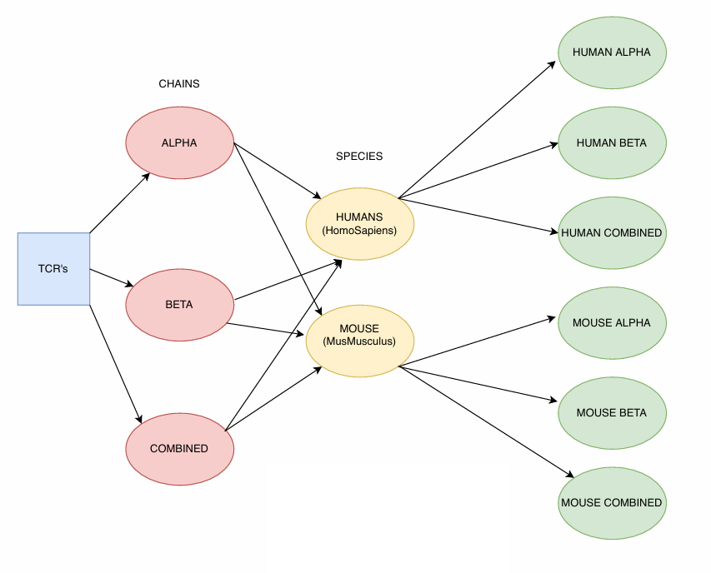
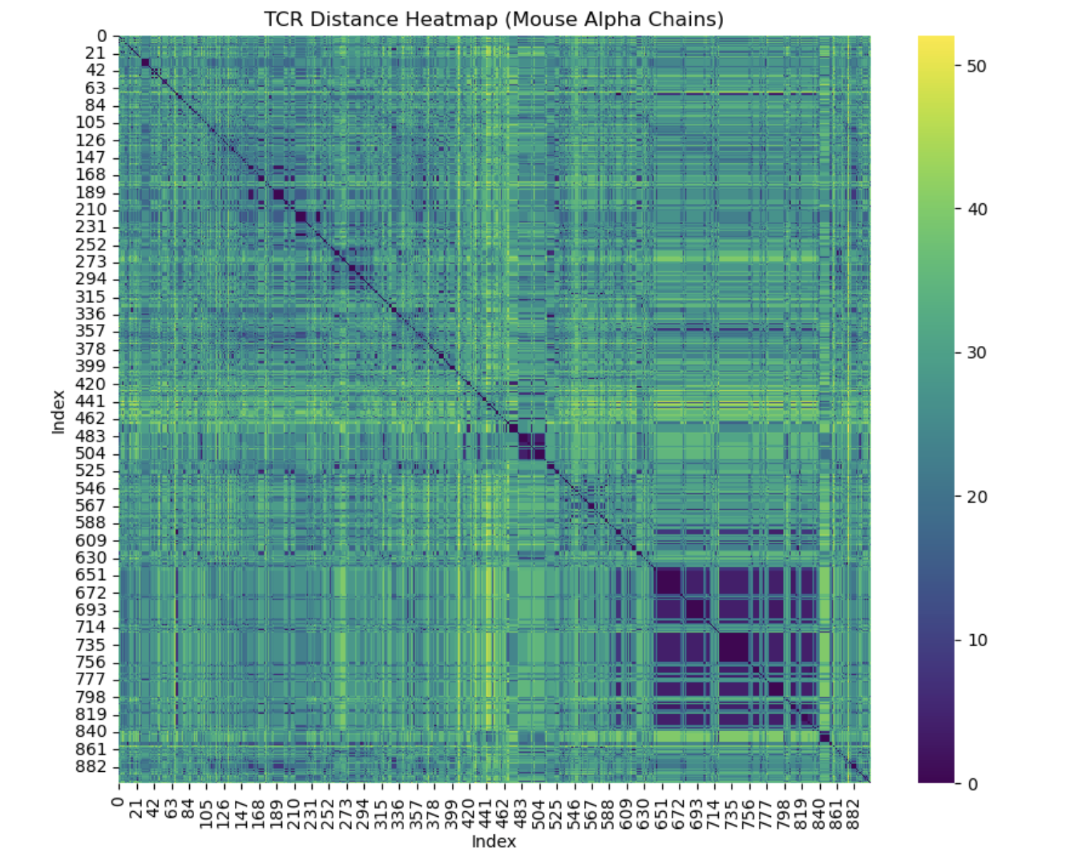
TCR DISTANCE CALCULATION:
TCR distance is a measure of similarity or difference between two T-cell receptor (TCR) sequences. TCRs are crucial components of the adaptive immune system, recognizing and binding to specific antigens to initiate immune responses.
The specificity of a TCR for a particular antigen is influenced by the structure and sequence of its variable region, especially the CDR3 (complementarity-determining region 3) loop.
Understanding the distance between TCR sequences is essential for studying their antigen specificity because similar TCRs often recognize similar antigens.
TCRdist is a specialized distance metric for TCR sequences that accounts for the amino acid properties and the structural context of the TCR.
It uses a BLOSUM62 substitution matrix to score pairwise substitutions and considers the structural alignment of TCR sequences.
TCRdist provides a more nuanced and biologically relevant measure of TCR similarity compared to Levenshtein distance.
To evaluate the TCR sequences, we calculated the TCR distances using the TCRdist methodology and Levenshtein distance. These measures provided insights into the similarity and specificity of TCRs, allowing us to cluster and analyze them based on their antigen recognition properties.

Slide 7
1 SLIDE ON TCR LEVENSHTEIN DISTANCE CALCULATION
LEVENSHTEIN DISTANCE CALCULATION TO BE ADDED HERE AND EXPLAINED BY FANGNAN

Slide 8
ANALYSIS ON DIMENSIONALITY REDUCTION OUTCOMES USE ABOUT 1-2 SLIDES
TO BE ADDED BY JIADONG AND TO BE EXPLAINED BY HIM IN THE PRESENTATION

Slide 9
1 SLIDE ANALYSIS ON CLUSTERING RESULTS
CLUSTERING RESULTS (DBSCAN)TO BE ADDED HERE AND EXPLAINED BY JIADONG

Slide 10
1 SLIDE ANALYSIS ON CLUSTERING RESULTS
CLUSTERING RESULTS (AGGLOMERATIVE)TO BE ADDED HERE AND EXPLAINED BY FANGNAN

Slide 11
MODEL CREATION AND OUTCOMES:
- A decision to focus exclusively on Human Species (Homo Sapiens) was made for model building and predictions due to the significantly larger volume of data available—51,535 entries for humans compared to just 4,173 for mice (Mus Musculus). This stark disparity allows for a more robust and generalizable model for humans, where the richer dataset ensures more reliable predictive performance. Additionally, focusing on human data aligns with the primary goal of applying findings directly to human medicine, avoiding the risks of undertraining and overfitting associated with the limited mouse data. This approach not only makes efficient use of the extensive human data but also enhances the clinical relevance of the predictions.
- Logistic regression was chosen as the baseline model for predicting TCR specificity due to the robustness of the logistic regression model and the simplicity of the binary classification task driving the choice.
- The primary evaluation metric chosen is the F1 score because the accuracy of the model can be misleading due to the unbalanced nature of the dataset.
- This is particularly important given the variability in epitope representation within the dataset.
- Model evaluation revealed that while the overall accuracy appeared high at approximately 87.5% for the alpha chains and 87.75% for the beta chains, the F1 scores for many classes were very low, indicating poor performance in correctly classifying many specific epitopes. This discrepancy between high accuracy and low F1 scores highlighted the challenges of working with imbalanced datasets and underscored the necessity of choosing appropriate metrics for performance evaluation.

Slide 12
SVM:
- The SVM classifier recorded accuracy rates of about 87.51% for alpha chains and 89% for beta chains. This performance is quite similar to what was observed with the logistic regression model.
- A closer examination of the F1 scores from the classification report reveals that the SVM faces difficulties with several classes, with many achieving zero F1 scores. This highlights the challenge of dealing with minority classes in an imbalanced dataset. Nonetheless, the SVM does excel in specific areas, achieving perfect F1 scores in some classes where logistic regression struggles.
- This shows the SVM's strength in handling certain segments of data where its optimization techniques are most effective, particularly in balancing precision and recall, as reflected by a weighted average F1 score of 0.88 for both alpha and beta chains.
- Although the accuracy of the SVM is similar to that of logistic regression, its higher F1 scores in certain classes suggest it could offer more dependable predictions for specific T-cell receptor specificities.
Random Forest Classifier:
- The Random Forest classifier, when applied separately to the Alpha and Beta chains, shows notable strengths and weaknesses in performance. Both chains achieve high accuracy levels, with approximately 90% for Alpha and 92% for Beta, indicating the model's strong overall predictive power across the dataset.
- However, a more detailed analysis using F1 scores reveals varied performance across different epitopes. Many classes exhibit low or even zero F1 scores, indicating challenges in classifying minority classes within the imbalanced dataset. On the other hand, some classes achieve high F1 scores, demonstrating the model's ability to accurately identify specific classes.
- The notable weighted average F1 scores of 0.91 for Alpha and 0.92 for Beta show its effectiveness in balancing precision and recall among diverse classes, making it a strong option for addressing the complexities of TCR specificity.

Slide 13
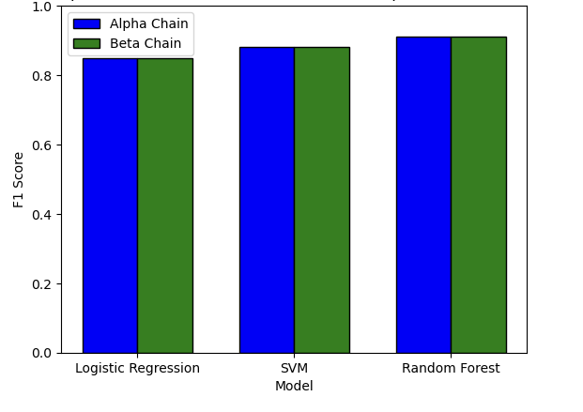
Despite the Random Forest Model’s success in general accuracy and class-specific predictions, there is still room for enhancement in precision across the board, suggesting a need for further model refinement.
Hyperparameter Tuning on the Random Forest Model:
After refining the model's settings, we noticed clear improvements.
- For the Alpha chain, adjusting the hyperparameters boosted the weighted average F1 score to 0.91, demonstrating enhanced balance in predicting various classes accurately.
- The Beta chain exhibited similar improvements, achieving a weighted average F1 score of 0.91 as well.
- These improvements suggest that the refined Random Forest model handles the dataset's varied and skewed distributions more effectively, resulting in more dependable predictions. -Such enhancements are especially valuable in clinical environments, where precise model predictions are essential for designing effective T-cell receptor-based immunotherapies.

